Slide 1
MOSFARM LLC
Pharmaceutical Company

Slide 2
Started in 2005, MOSFARM LLC Pharmaceutical Company was designed and built from ground zero. MOSFARM LLC's core business is infusion solutions production.
The consistent high quality of our medicines, achieved through compliance with GMP (Good Manufacturing Practices) regulations, has earned us customer satisfaction, guarantees that our products conform to their intended use and eliminates hazards for patients.
For this purpose, we only use "cleanroom" equipment and supplies, state-of-the-art production equipment and latest quality control laboratory equipment from international and domestic manufacturers.

Slide 3
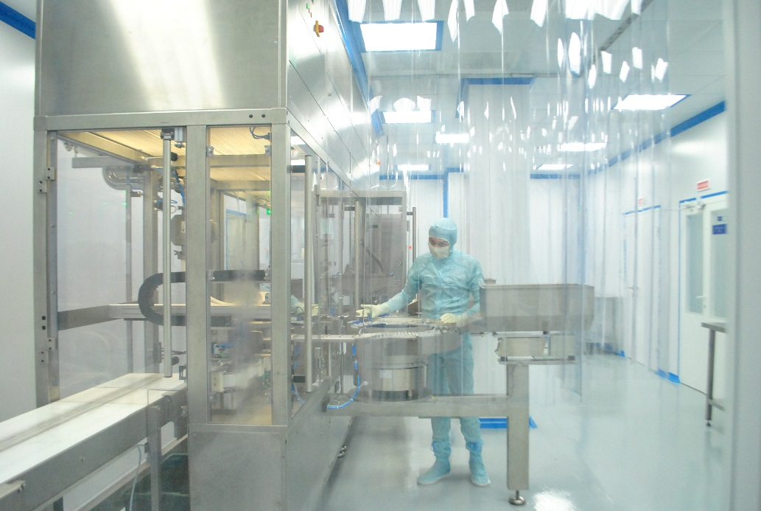
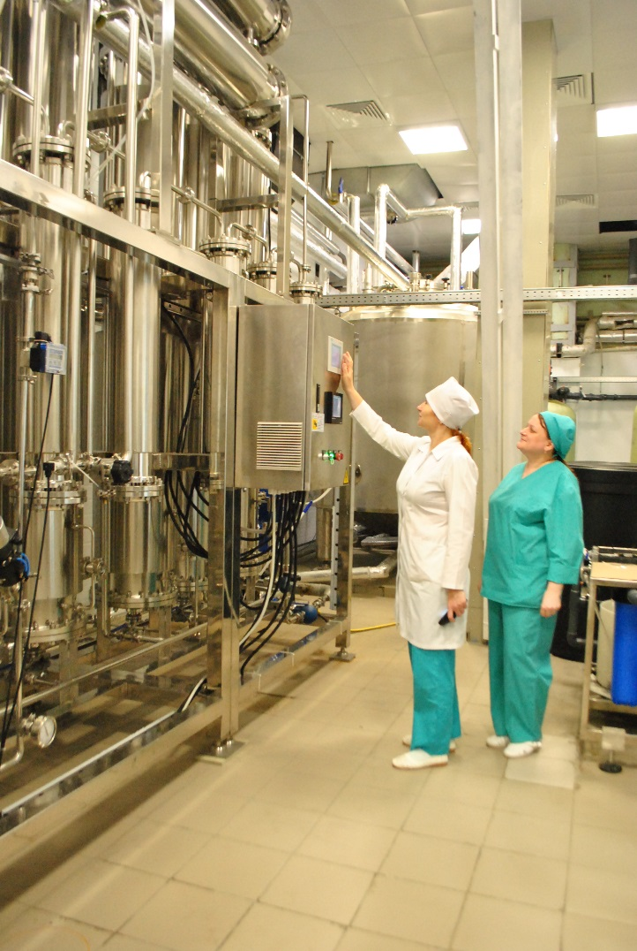
The company has a quality assurance policy covering the development and production of finished pharmaceutical products to meet the demand for highly effective, safe and high-quality, including import substitution-oriented, medication. The company has developed and approved a Document Management System with active contribution from specialists of the State Institute of Blood Substitutes and Medicinal Preparations and the Sechenov Medical Academy in Moscow.
The effectiveness of the quality assurance system is based on cultivating the responsibility of the team as a whole as well as the individual team members. We routinely support the professional development of our employees and encourage the national and professional self-awareness of our team to grow as part of the international pharmaceutical community.

Slide 4
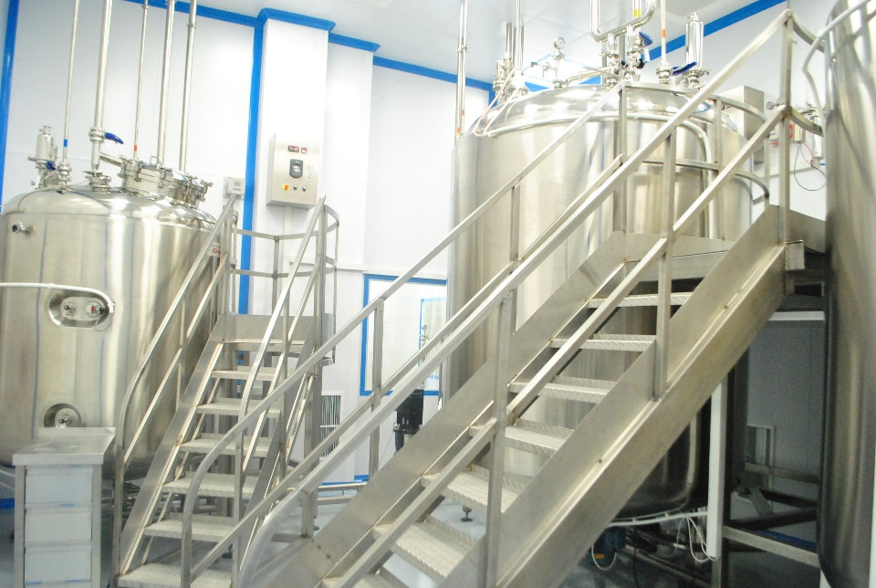
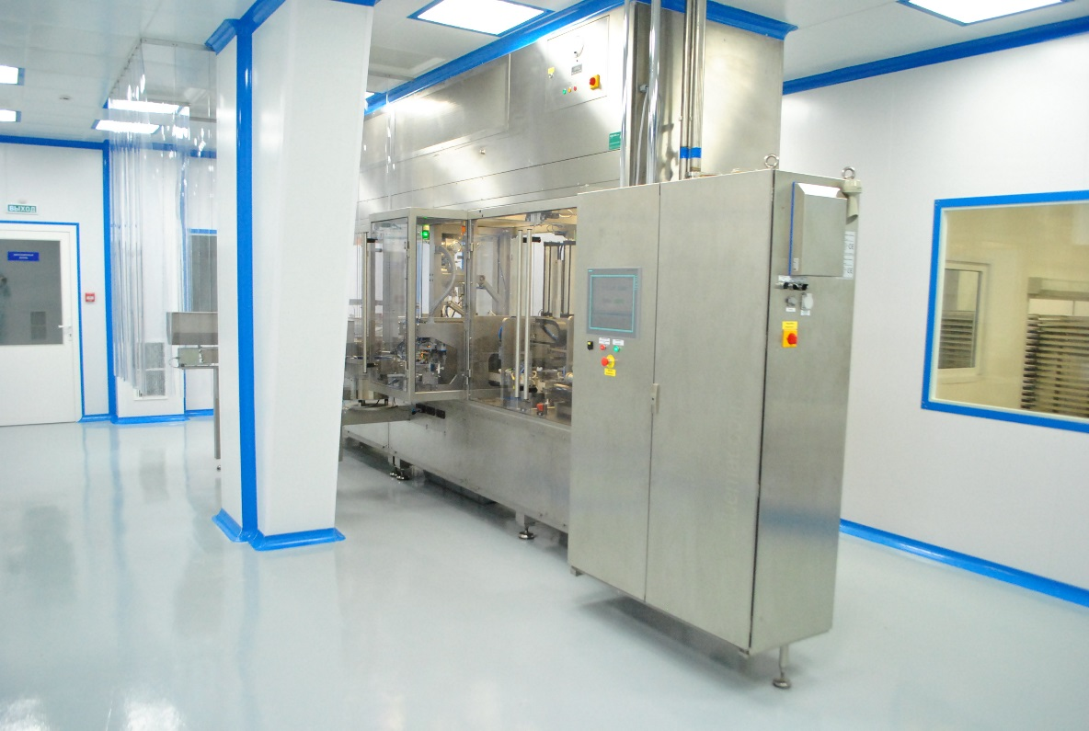
MOSFARM LLC developed and formalized its Quality Management System to conform to GOST R ISO 9001-2008 "Quality Management System. Requirements." and the industry requirements as per GOST R 52249-2009 "Good Manufacturing Practice for Medicinal Products" in respect to the existing organizational management structure approved by the CEO.
In March 2015, the company launched a new production site for infusion solutions in plastic containers. To demonstrate compliance of its process parameters, MOSFARM LLC has successfully completed the qualification and validation of its premises, equipment and processes used to manufacture medicinal products.
MOSFARM LLC is planning to expand its pharmaceutical production and product portfolio to provide consumers with high-quality, effective and affordable medicines produced domestically.

Slide 5
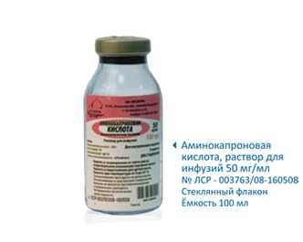
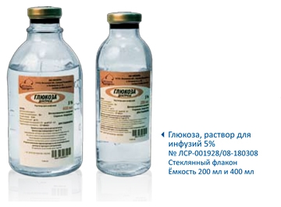
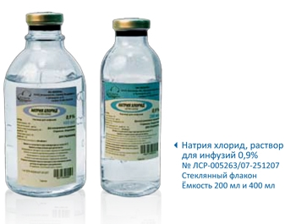
MOSFARM LLC is a pharmaceutical company manufacturing large-volume sterile dosage forms produced using heat sterilization — solutions for infusions, as well as packaging for solid dosage forms.
MOSFARM's main production program is infusion solutions in glass bottles of 100, 200 and 400 ml:
Sodium Chloride 0.9%
Glucose 5%
Glucose 10%
Асеsolum
Disolium
Trisolum
Ringer's solution
Procaine 0.5%
Procaine 2.5 %
Haemodesum H
Rheopolyglucon-40
Sodium Carbonate 5%
Aminocaproic acid

Slide 6
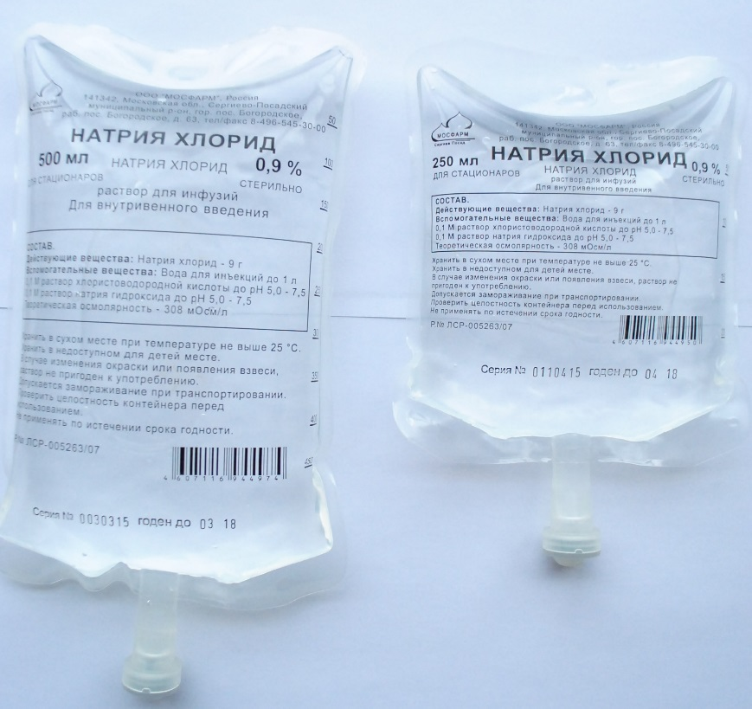
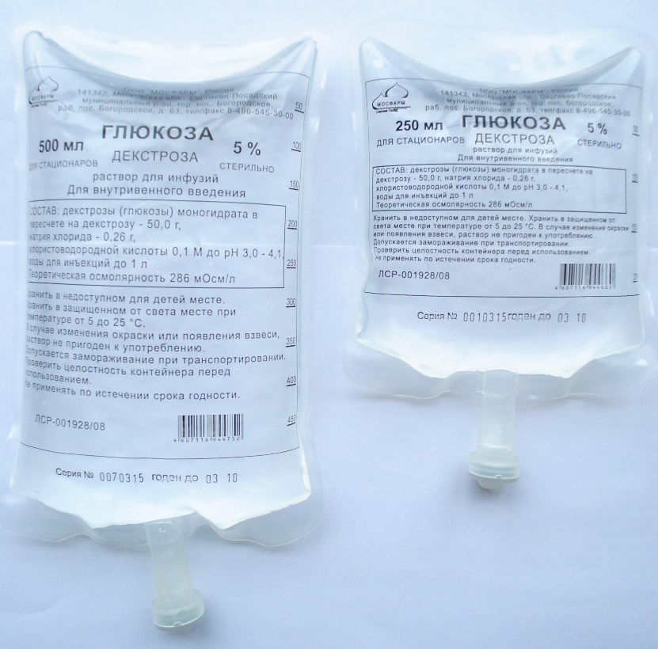
MOSFARM started a new production facility with a German PLÜMAT high-speed automated production line and expanded its production to include infusion solutions in 100, 200, 250, 300, 400, 500, 1000, and 3000 ml polymer containers made of polyolefin film.
The self-folding polymer container made of multilayer polyolefin film is free from polyvinyl chloride, has an SFC injection port and a rubber stopper. The container has one port (or two ports), a cap with tamper-evident seal and a hanging loop. The container is compatible with IVs that have no air filter. The polymeric container is graduated to 50mL. The container has no secondary packaging.
The transparent film allows 100% control of particulate contamination. The markings are printed thermographically on the container before it is filled.
In these polymer containers, solutions can be frozen during transportation. The containers remain air-tight when frozen and restore their properties at room temperature.

Slide 7
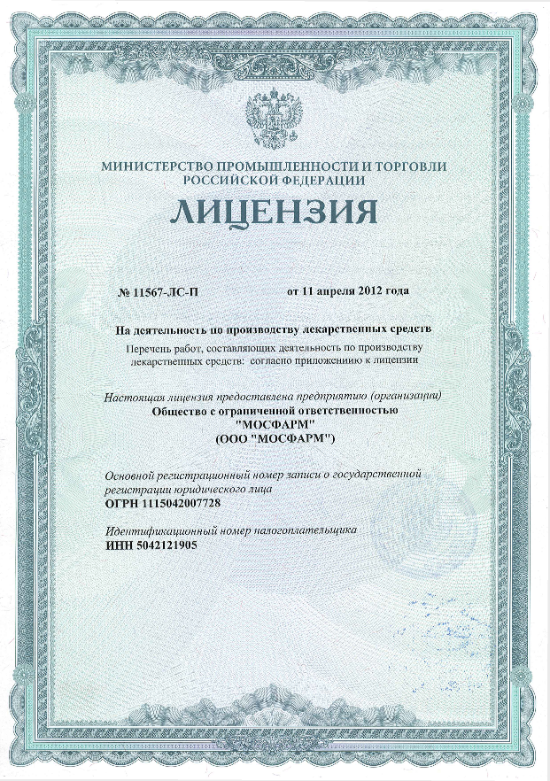
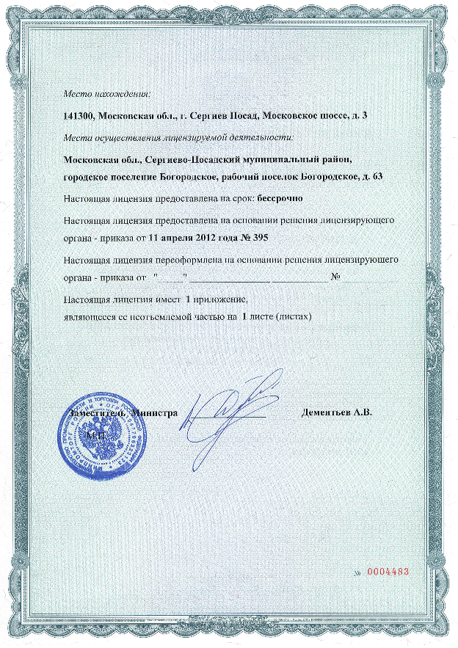
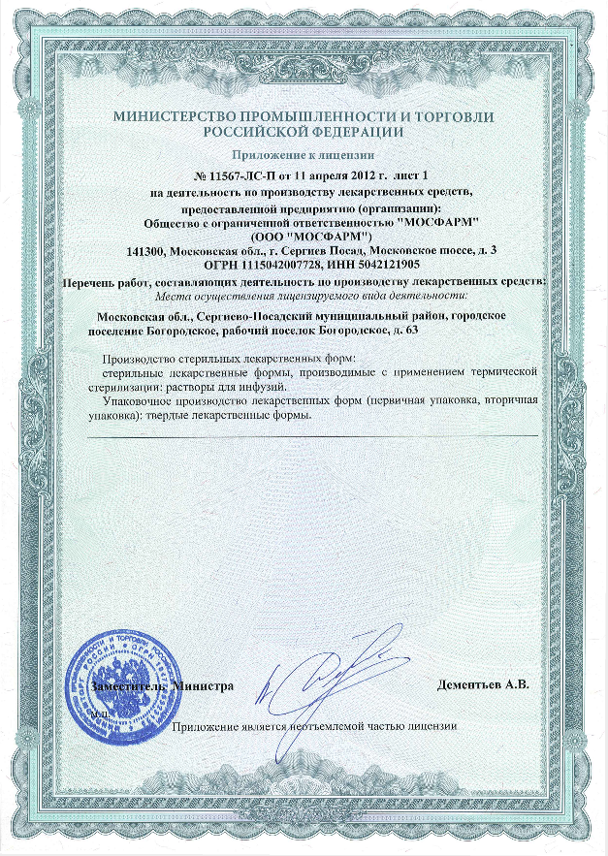
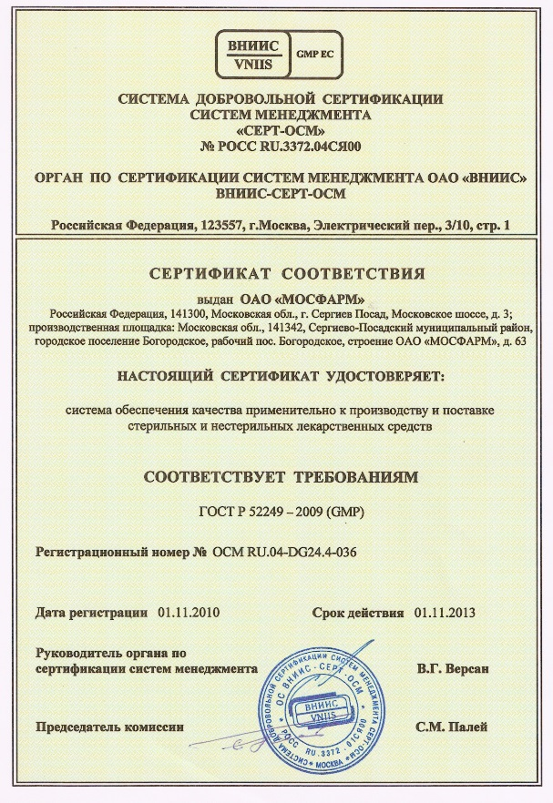
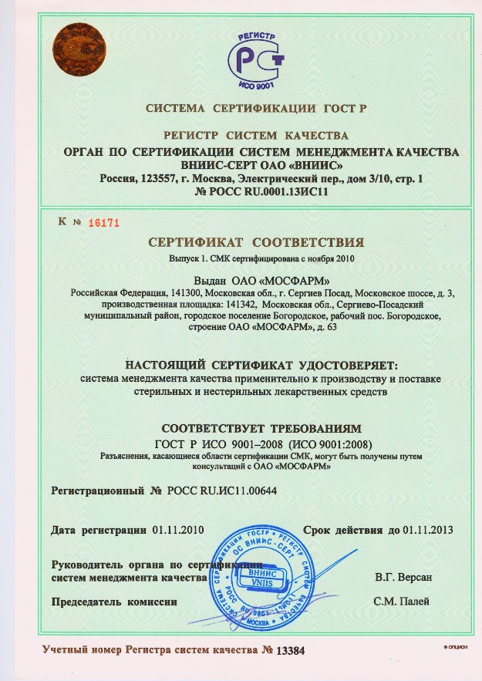
We are open to new business opportunities that reflect the interests of our consumers. With our flexible pricing policy and our modern logistics system allowing quick delivery of our products anywhere in the country, we can offer our clients the best and mutually rewarding relationships.
We are always open to dialogue and innovation!

Slide 8
MOSFARM Limited Liability Company
63, Bogorodskoye urban community, Sergievo-Posadskiy Raion, Moscow Oblast, 141342
Tel.: 8 (496) 545-30-00
E-mail: info@mosfarm.su
Internet: www.mosfarm.su
Sales:
Tel.: 8 (496) 545-42-95
E-mail: sale@mosfarm.su

